Slide 1
I
H
F
R

Slide 2
I
ntroduce
Akshat Kashyap (20BTRCL004)
Neell Ravindra Ambere (20BTRCL041)
Shriyans Kandhagatla (20BTRCL053)
Pratham Chopra (20BTRCL076)
H
F
R

Slide 3
I
H
F
R

Slide 4
I
H
istory
C
With ancient roots, Tic-Tac-Toe evolved from traditional European games in the 19th century. Its simplicity led to widespread popularity in the 20th century, becoming a universally recognized game used for teaching programming and algorithm design in computer science.
Tic-Tac-Toe, also known as Noughts and Crosses, is a classic pencil-and-paper game played on a 3x3 grid. The goal is to form a line of three of the same symbols ("X" or "O") horizontally, vertically, or diagonally.
R

Slide 5
I
H
F
R

Slide 6
I
F
eatures
H
Multiplayer & Solo Play:
Enjoy with friends or go solo against an AI opponent.
Seamless switch between multiplayer and single-player modes.
Auto-Reset Feature:
Effortless transitions between rounds.
Game board resets automatically after each completed match.
R

Slide 7
I
H
F
R

Slide 8
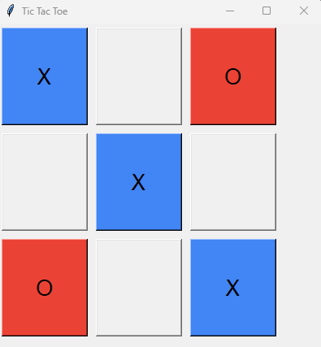
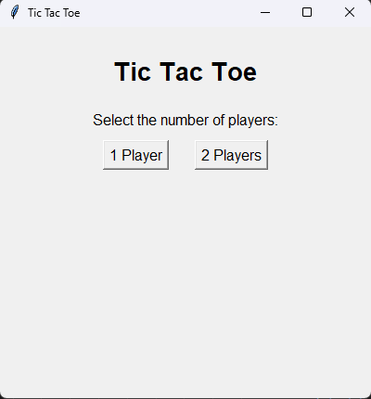
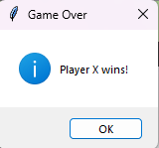
I
H
F
R
esult

Slide 9
I
H
F
R

Slide 10
I
H
F
R

Slide 11
I
H
F
THANK YOU!!!
R

